Slide 1
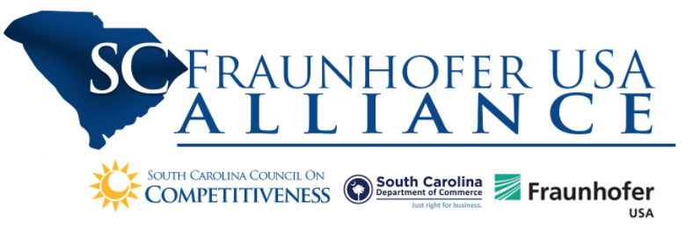



Proactive and Automated Control for BMW

Slide 2
Problem Statement
Challenge
BMW assembly processes integrate thousands of parts, sourced from a wide variety of suppliers, located around the world
If these parts fail to arrive on time, costly delays and work stoppages follow
Requires monitoring that is done manually by highly experienced supply chain professionals
Tedious and expensive
Solution
Improved data-driven algorithms, systems and processes
Capture, analyze and exploit datasets to enable optimized and proactive materials control, optimize specialized human expertise, and reduce line stoppages due to missing parts
Scalable

Slide 3
Statement of Work from Proposal
Phase 1: Data Collection and Development
Data collection and analysis
Develop models representing a wide range of data and interrelationships
Identify subset of “easy to plan” parts, automate handling of these parts, suggest actions to take given a part’s status
Evaluate path to full automation of low-risk parts
Phase 2: Proactive and Automated Reporting Integration
Validate and enhance developed models and AI material planner
Develop dashboards and reporting
Reduce material planner’s efforts to increase efficiency
Enhancement over current methods (SAP)

Slide 4
Tasks/Deliverables Listed in Proposal – Phase 1
Task # | Description | Deliverable | Time Range
BMW 1 | Gather and provide the partners with historical BMW data | Historical BMW data delivered to partners | Months 0-1
UofSC 1 | Exploration of historical BMW and extraneous data for forecasting part deliveries | Document: Key figures from historical data, rich/poor areas, supplier ranking | Months 0-2
FhUSA 1 | Stakeholder interviews to identify how material planners approach problems | Prototype ER model, Presentation to stake holders | Months 0-2
UofSC 2 | Data formatting and interrogation to identify relationships in data and capabilities of forecasting model | Key capabilities for part-forecasting model and prepared data for model creation | Months 2-5
BMW 2 | Assist in AI material planner development | Active support and reviews | Months 2-5
FhUSA 2 | Create AI Material Planner Assistant Prototype | Software: AI model material planner prototype. Workshops with partners to prepare integration | Months 2-5
UofSC 3 | Develop parts forecasting model | Software: AI model prototyping forecasting capabilities | Months 4-6
FhUSA 3 | AI assistant model validation | Tutorial on AI model, signals and patterns. Updated AI Model | Months 5-6
BMW 3 | Perform model validation and testing | Active support and reviews | Months 5-6
Midterm Review – Demonstration of AI parts forecasting model and AI planning assistant prototypes

Slide 5
Tasks/Deliverables Listed in Proposal – Phase 2
Task # | Description | Deliverable | Time Range
UofSC 4 | Parts forecasting model validation | Software: Validated AI model | Months 7-9
FhUSA 4 | Integrate forecasting model with AI Material Planner | AI Material planner framework with integrated AI forecasting model | Months 7-9
BMW 4 | Systems of record integration |  | Months 7-9
FhUSA 5 | AI Material Planner with alerting and human readable steps created | Workshops: status updates, alerting functionalities, human readable action steps. Software: Alerting functionality, human readable action steps. Software support: support BMW with integration of system at BMW. Correction calibration of system | Months 9-12
BMW 5 | Integration of combined parts forecasting model and AI material planner |  | Months 9-12
BMW 6 | Visualization, dashboard and reporting |  | Months 7-11
BMW 7 | Feasibility study and testing | Document: Feasibility study report, final report | Months 10-12

Slide 6
Initial Timeline
Kickoff
Midpoint Review
Month 1 | Month 2 | Month 3 | Month 4 | Month 5 | Month 6 | Month 7 | Month 8 | Month 9 | Month 10 | Month 11 | Month 12
UofSC 1 |  |  |  |  |  | UofSC 4
 |  | UofSC 2
 |  |  | UofSC 3
FhUSA 1 |  |  |  |  |  | FhUSA 4
 |  | FhUSA 2 |  |  |  |  |  |  | FhUSA 5
 |  |  |  | FhUSA 3
BMW 1 |  |  |  |  |  | BMW 4
 |  | BMW 2 |  |  |  |  |  |  | BMW 5
 |  |  |  | BMW 3 |  | BMW 6
 |  |  |  |  |  |  |  |  | BMW 7

Slide 7
Objective and Solutions
Broad Objective: How can we reduce material planner efforts?
The user dashboard can integrate all needed data and analysis into one location for the planner.
Various widgets
Parts Ranking, Live Material Location during Transportation, KPIs like exceptions
Requires meetings with BMW to identify the KPIs of interest
Parts Health Status Model
Provide Key Performance Indicators (KPIs) on dashboard that could guide material planner to reduce their daily efforts.
Recommend best practices for the material planner.
Recommendation engine is one tool that is used to achieve this objective

Slide 8
Dashboard
Provide Key Performance Indicator (KPIs) on dashboard that could guide material planner to reduce their daily efforts.
KPIs
Health Status (KPI # 1)
Part Ranking (KPI # 2)
Questions to be investigated:
What are the KPIs for the material planner to reduce their daily efforts?
What are fields/columns in datasets to generate these KPIs?
What can be an Application logic/Algorithm to derive these KPIs?
What are use case scenarios/test cases scenarios to validate the results?

Slide 9

Decision Tree for KPIs
Algorithm, Application Logic, Rulesets
Supply
Purchase Order #
Trailer ID
Source of Shipment
Dest. of Shipment
ETA to Dest.
Supply TS
Weather
Traffic
…
Stock DoS
(number, in Days)
Exception
Exception ID (PK)
Exception Msg
AL
First Receipt DoS
(number, in Days)
Exception
KPI # 1
AL
Material Config.
Safety Stock
Planning Time Fence
Safety Time
Planning Calendar
…
Health Status
(number, 0-100)
KPI # 2
Material Transaction (MD04)
Demand Date
MRP Element
Change Qty
Total Qty
…
Part Ranking Algorithm
Part Ranking
Data Legend
No Issues in Accessing Data
Data is Accessible but Questions Exit
Data Not Available

Slide 10
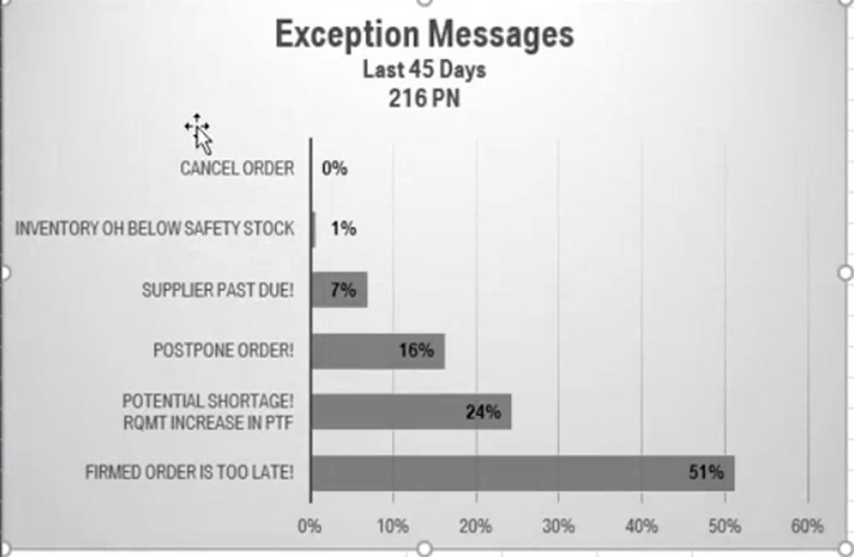
Capturing Best Practices – Exception Handling
Material Planner spends a significant amount of his/her daily time in reviewing exception messages.
Improve quality of decisions made by reducing overall number of exceptions
The team will investigate exception message related data to identify root causes of exceptions and recommendations for reducing the overall number.
During testing, feedback from material planners will be collected on how to address exceptions
Deliverable: Document detailing best practices for handling exception messages
Access to exception message data is required.

Slide 11
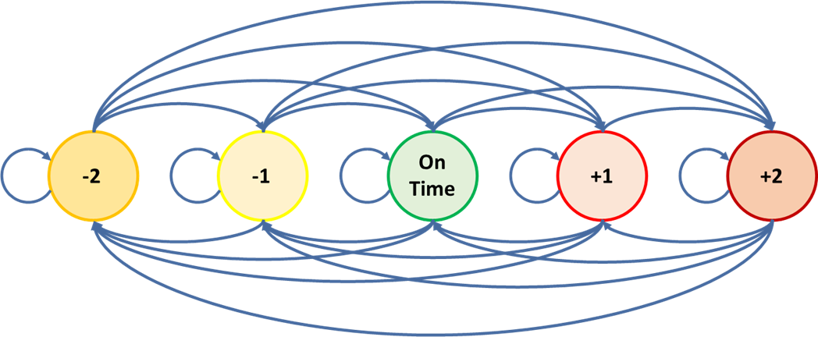
Capturing Best Practices – Parts Ranking
Utilizing Markov Chain and historical data, this model will predict the likelihood of a part arriving early, on time, or late.
Improve quality of decisions by identifying root cause of underperforming parts and the cause for delays allowing planners to take early action to prevent this from happening
The team will investigate supplier and material related data to predict arrival times and identify root causes of delays
During testing, feedback from material planners will be collected on how to address problems
Deliverable: Document detailing best practices for handling material delays
Access to historical shipping data is needed.

Slide 12
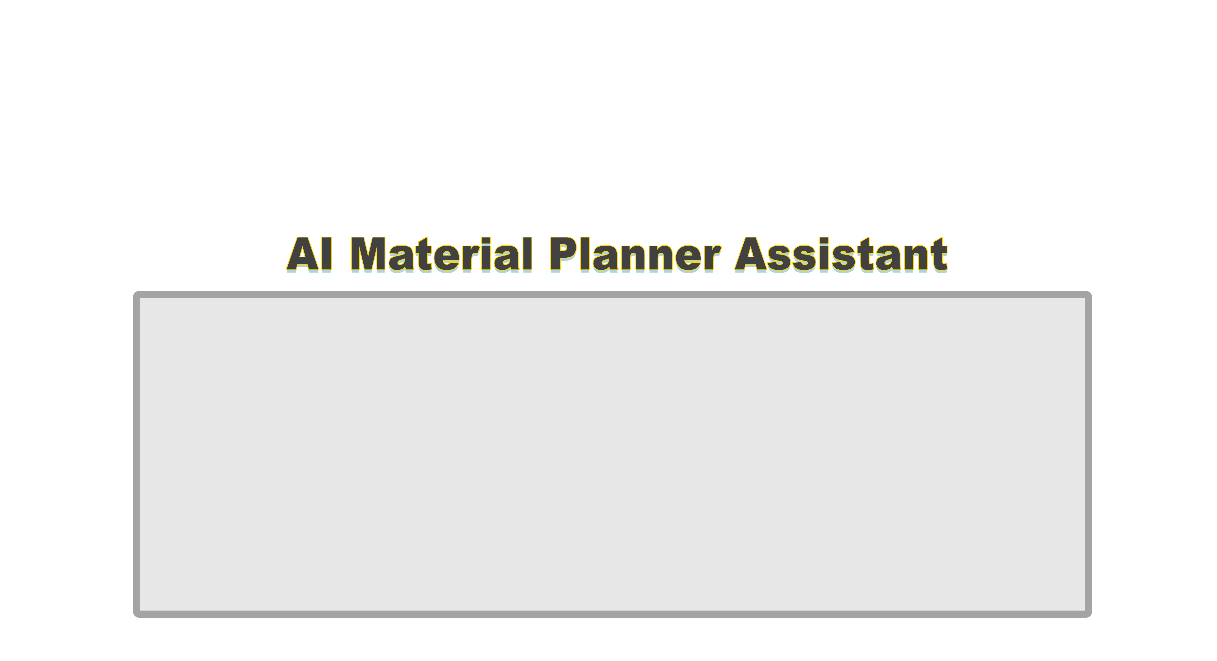
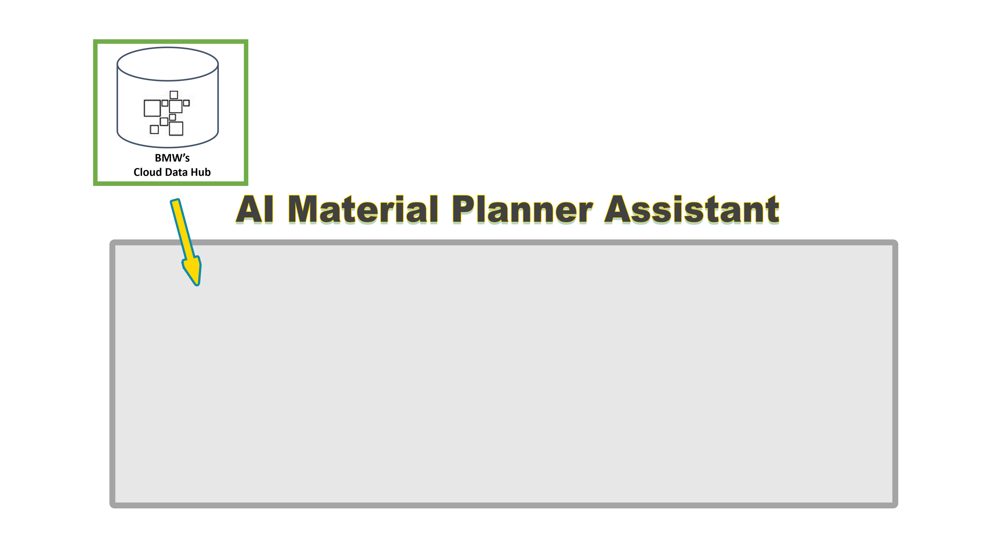
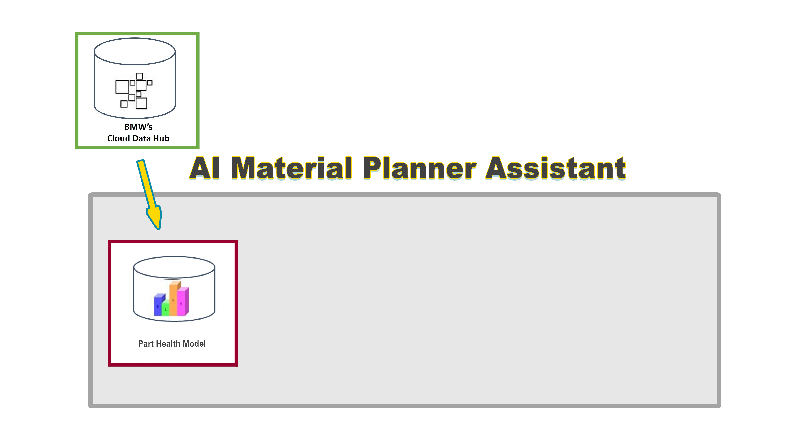
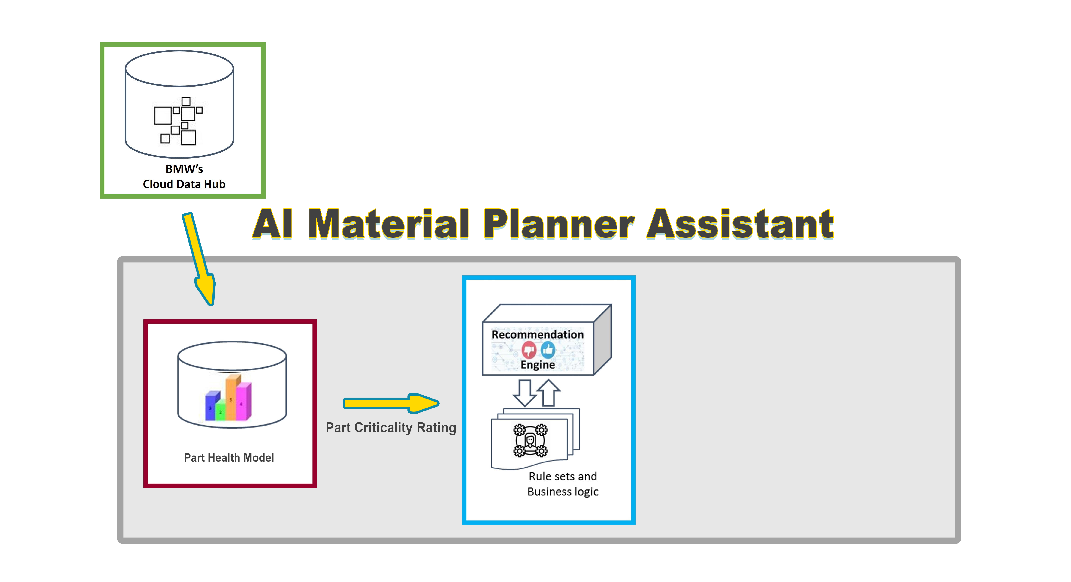
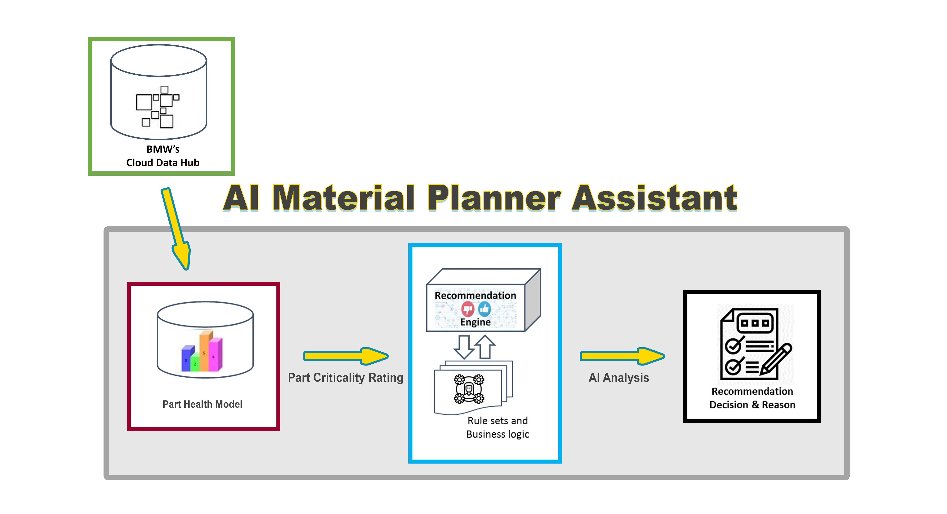
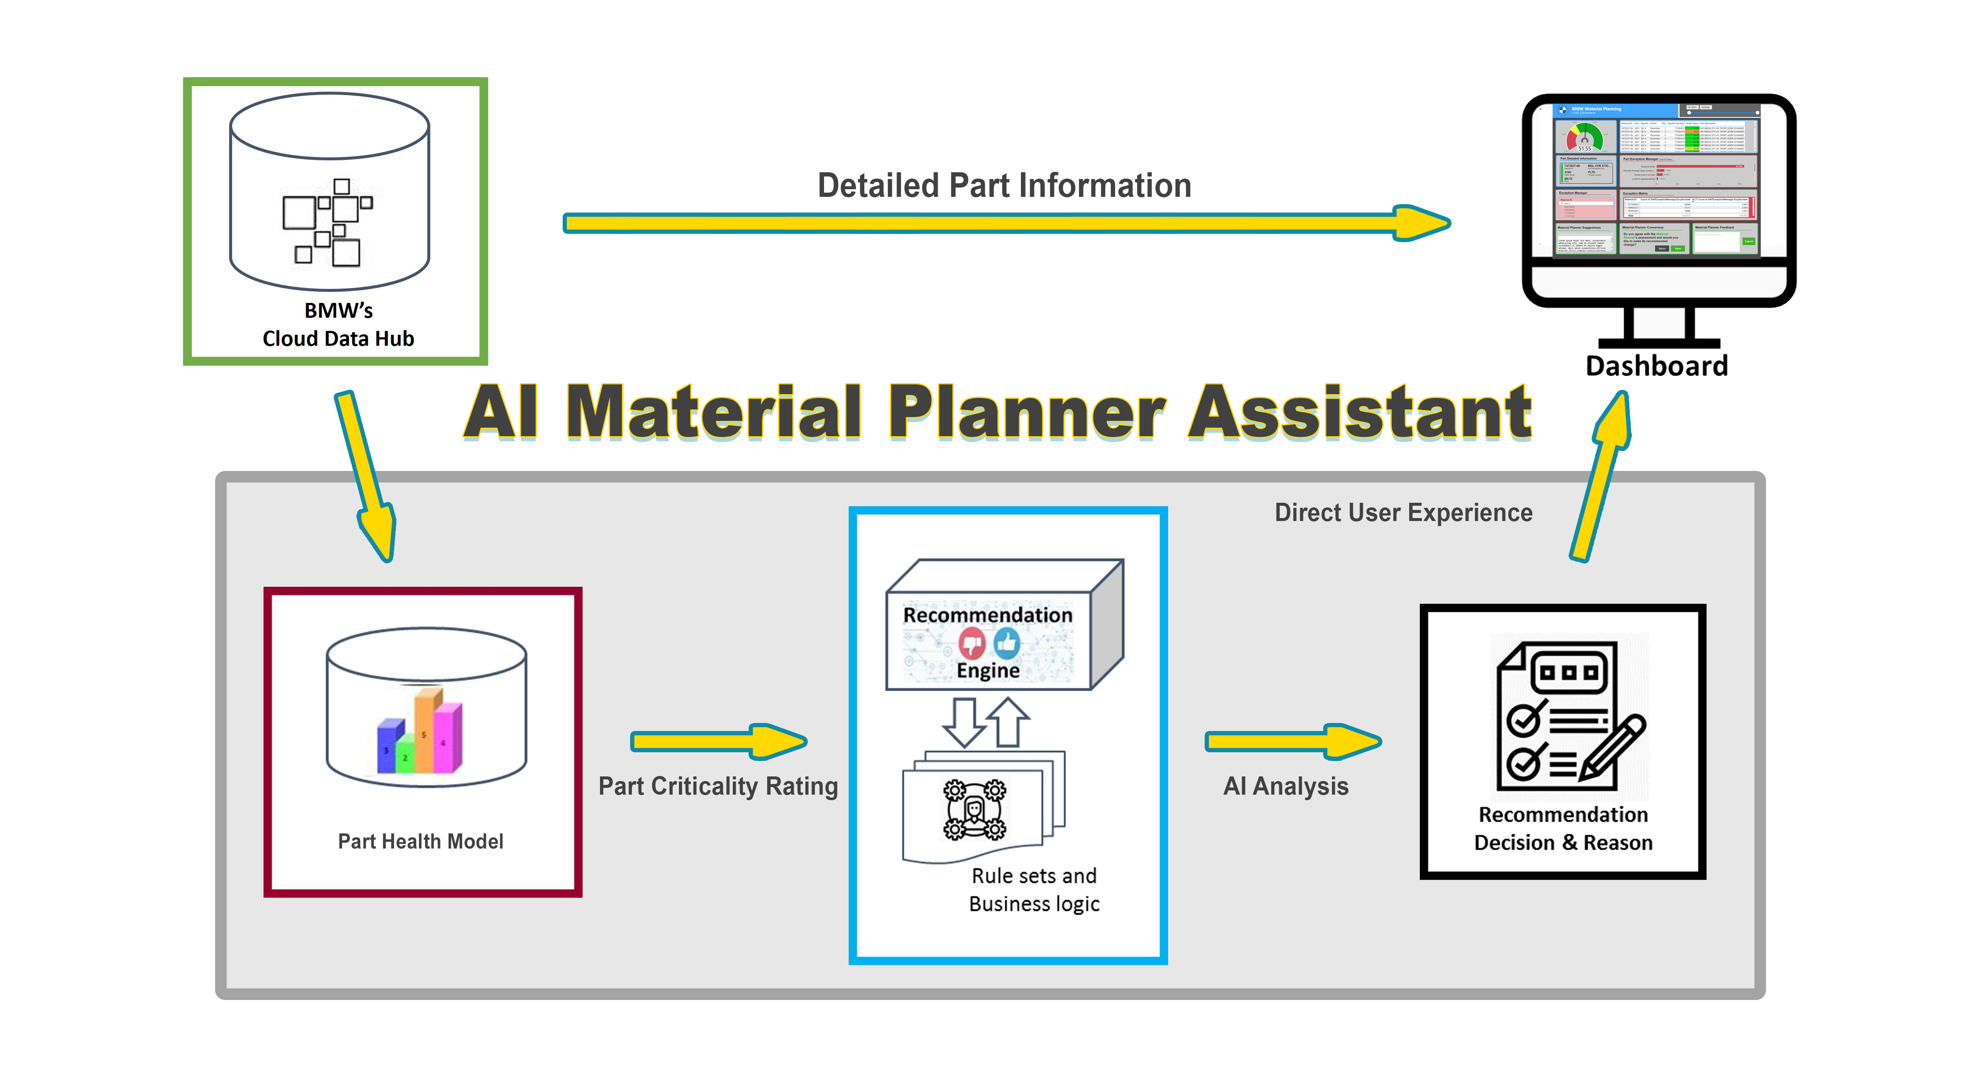
Material Planner Assistant

Slide 13
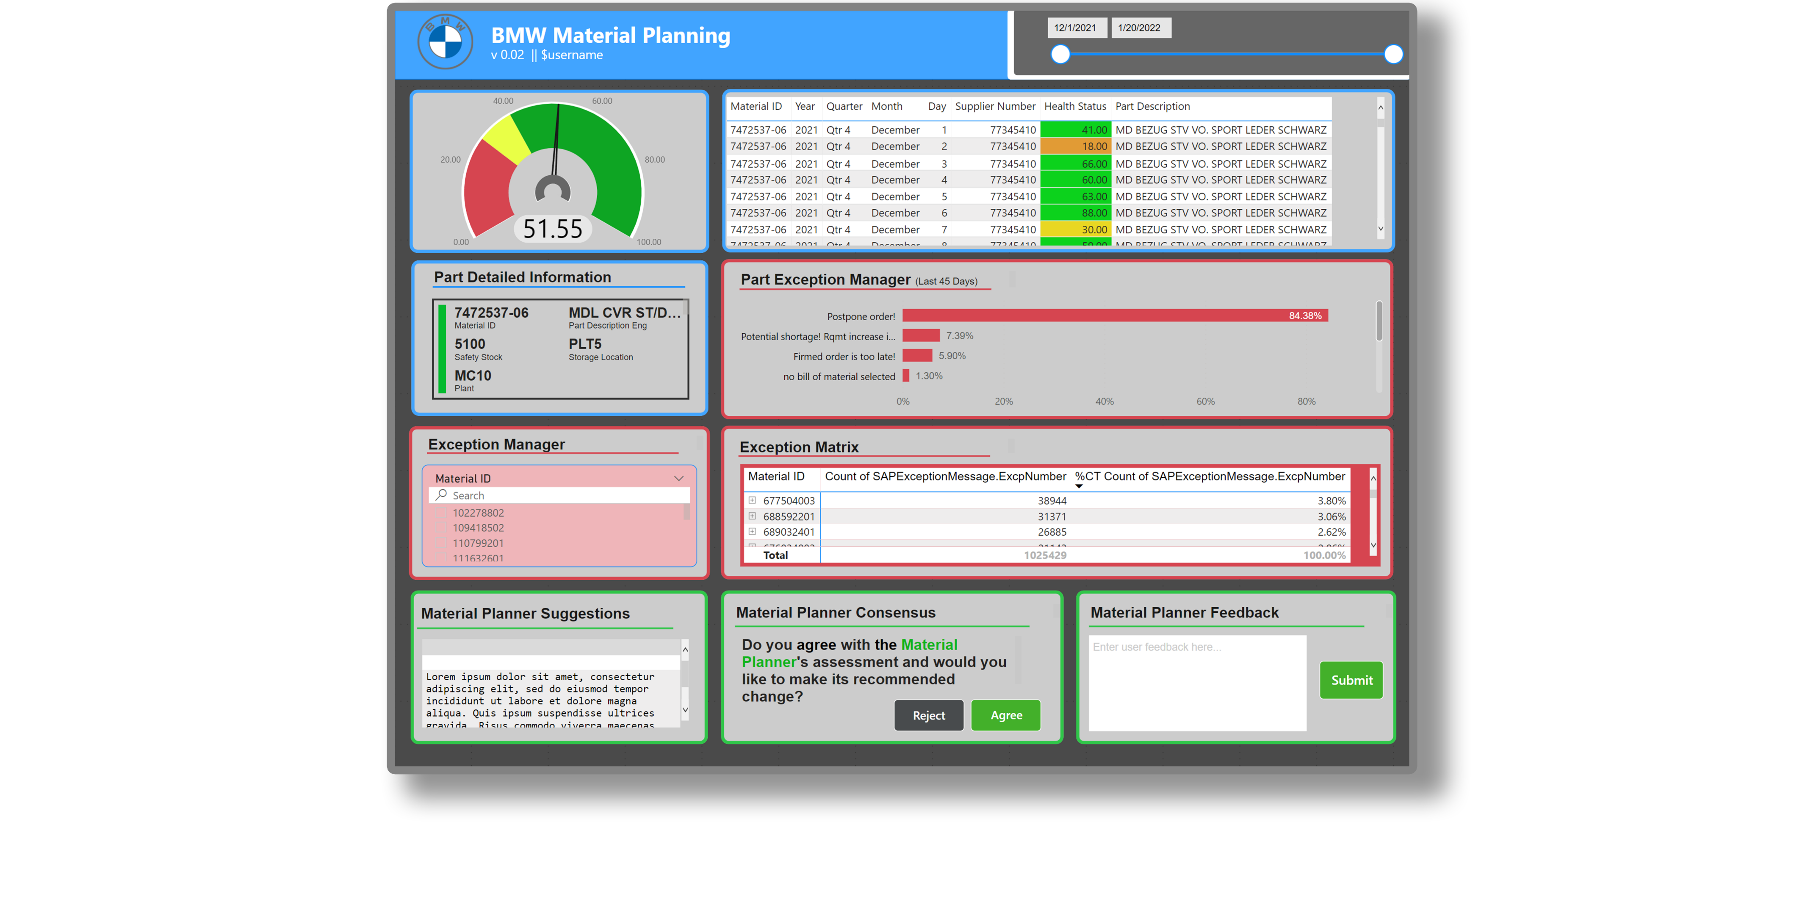
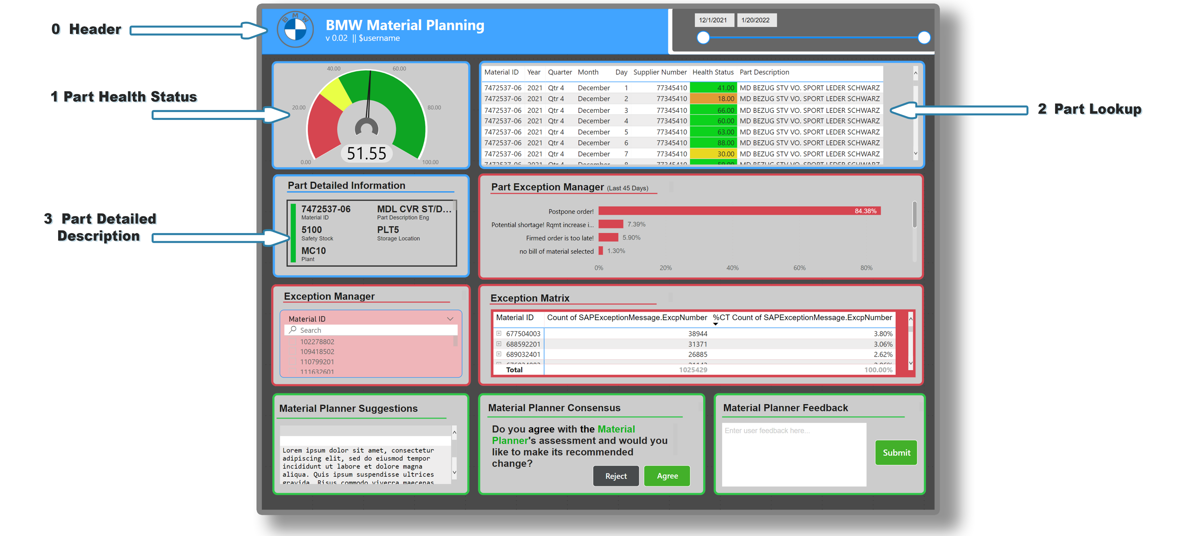
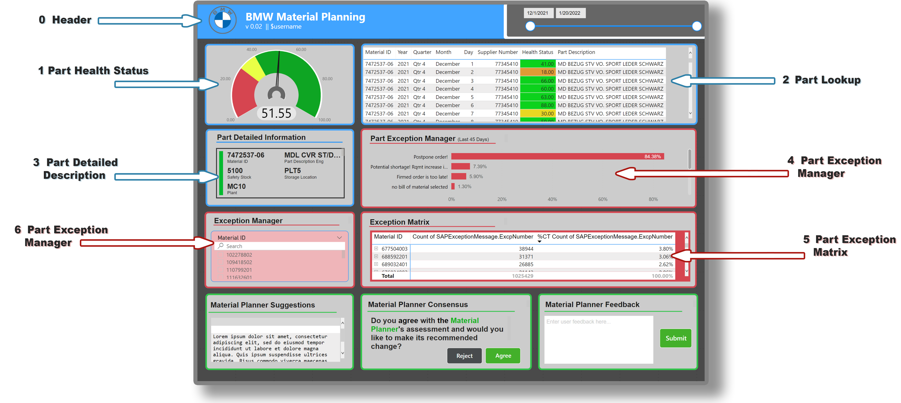
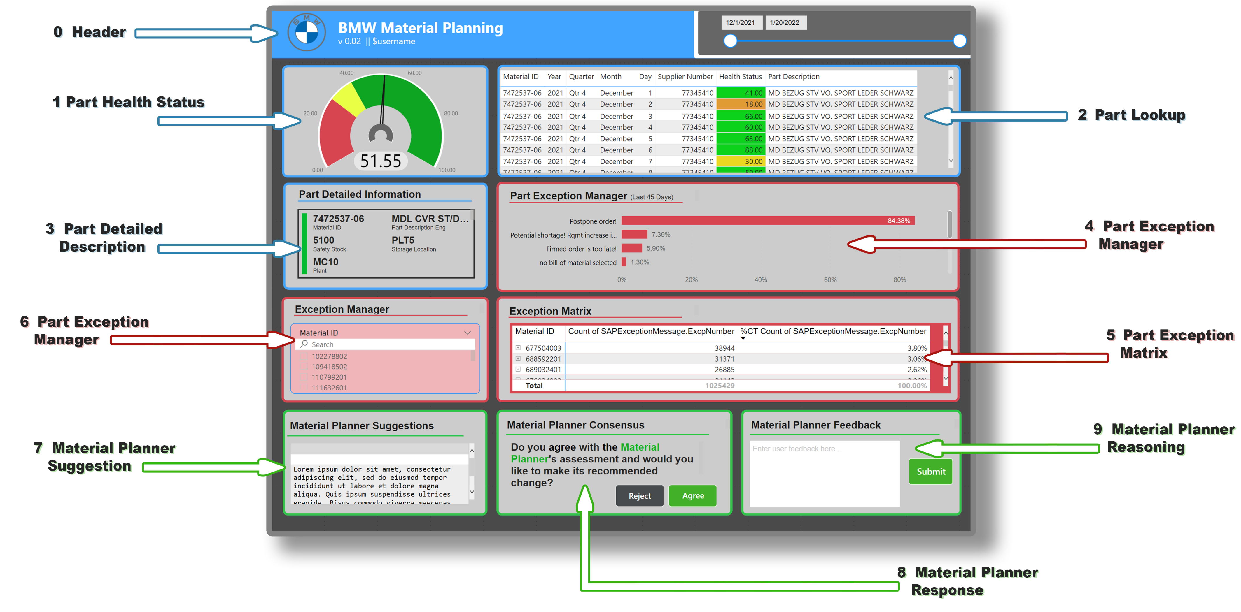
User Dashboards

Slide 14
Health Score Model
Phase 2
Additional data fields explored
Enhanced with machine learning techniques
Further validation and refinement
Repeat for following 10 days
Extract MD04 Data for specified material
Calculate average daily degradation of supply
Find ratio of stock to safety stock
Calculate Health Status
Predict DoS
Non-Linear Function

Slide 15
Part Ranking Algorithm
Based on historical data, we will be able to calculate the probability that an order will be early or late and by how many days for the next delivery.

Slide 16
Task 1: Dashboard Development
Duration: Jan-May 2022* (Months 7-12)
Deliverable: Dashboard that integrate outputs from Parts Forecasting model and recommendation engine and other widgets
Aim: Refine and validate dashboard developed in Phase 1
Sub activities:
Identify suitable technology stack to develop dashboard
Refine and validate dashboard developed in Phase 1
Deploy dashboard
Milestone: March 31, 2022*; Refined dashboard ready for evaluation
What is needed from BMW:
KPIs (e.g., health score, exception manager. etc.) to be developed into dashboard
Suitable datasets to develop KPIs
What is needed from Fraunhofer:
Recommendation engine APIs to be called from Dashboard
Database APIs/Database server to extract data from BMW cloud
*Dates to be determined

Slide 17
Task 2: Forecasting Model
Duration: Jan-May 2022* (Months 7-12)
Deliverable: Parts forecasting model ready to be integrated into AI MPA
Aim: Refine, test and validate parts forecasting model developed in Phase 1
Sub activities: (preliminary list)
Test and validate parts forecasting with historical data
Test and validate optimized parameters for parts ordering
Refine model as needed
Milestone 1: March 31, 2022*; Refined forecasting model ready for user testing
Milestone 2: May 31, 2022*; Refined and validated forecasting model based on user feedback
What is needed from BMW:
Suitable datasets and APIs (e.g., part delivery location etc.)
Deployment plan to deploy our Forecasting model
Scope of the forecasting model (e.g., our model will work for parts at MC10 plant, material parts considered for the model)
What is needed from Fraunhofer:
Establish database to capture material planner feedback
*Dates to be determined

Slide 18
Areas for Discussion/Clarification
Dashboard Development
Functional Dashboard vs Production Ready Dashboard - work with Suzanne’s team to Develop
Responsibility of development / support
How will the dashboard be deployed and accessed by users
Most important KPIs for dashboard
Study of existing dashboards for material planning at BMW
Data
How available are other data sources like transportation/shipping
Scope and End Users
Phase 2 will be focused first on a subset of parts (parts monitored by the 4 planners interviewed)
Deliverable
Dashboard tool that connects data and analysis, document outline best practices, troubleshooting/user manual for tool
End Date – 8/31/22

